Slide 1
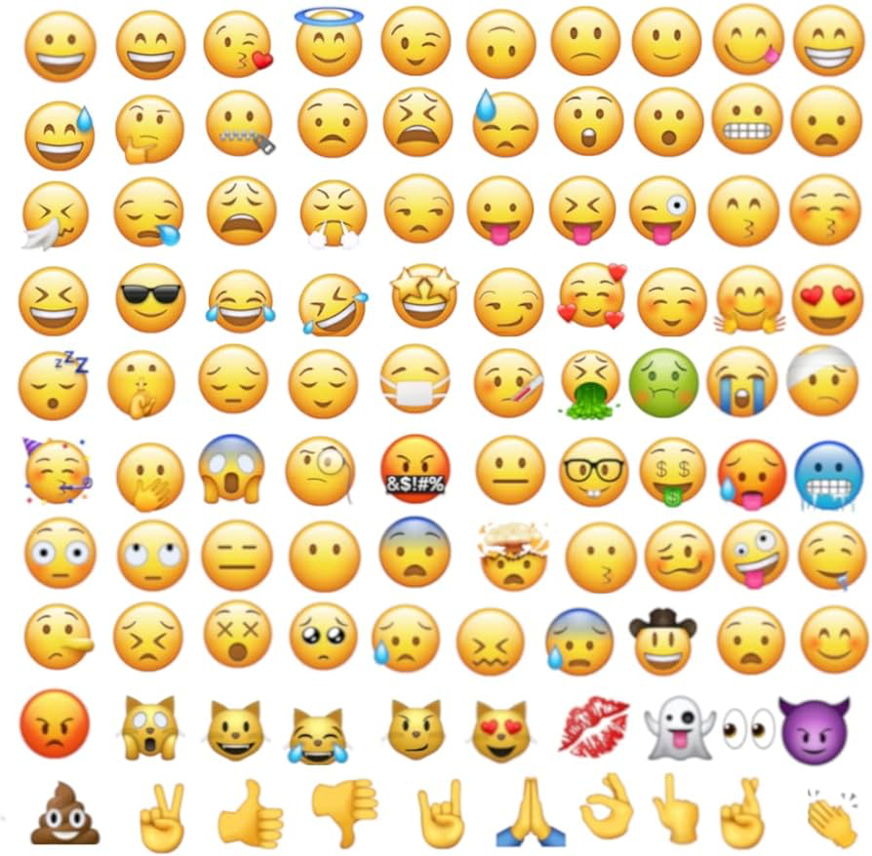

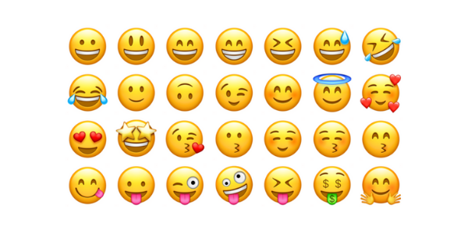
Multilabel Text Classification using Transformers
By: Heather Milano
Mohammad Arif Ul Alam, Assistant Professor, Miner School of Computer and Information Sciences
Christopher Geggis, Adjunct Professor, Miner School of Computer and Information Sciences

Slide 2
Outline
Multilabel Text Classification vs Traditional Text Classification
Dataset and Data Preprocessing
Algorithms and Model Architecture
Model Training and Evaluation Results

Slide 3
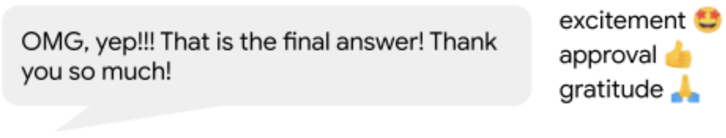
Introduction
Problem: emotion detection from texts
Importance:
For businesses: give insight into product/service success
For healthcare: determine mental health conditions
For schools: discover social media cyberbullying
Emotion classification is a step up from sentiment analysis

Slide 4
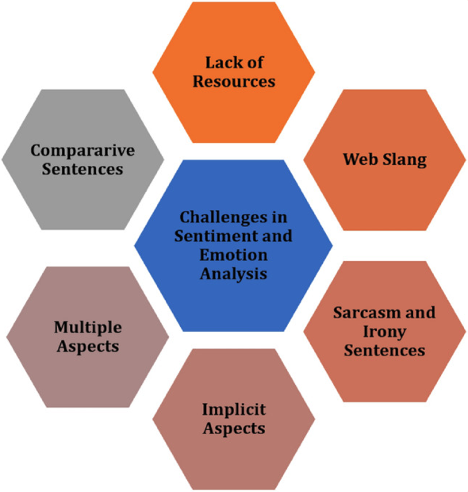
Related Works
Discusses the Ekman model of separating emotions into 6 categories: anger, disgust, fear, joy sadness, surprise. Compares different models using varying word embeddings. BERT model used for emotion detection in COVID-19 tweets reaches 75% accuracy (no other metrics listed). Also highlights the challenges in sentiment analysis and emotion detection.
Describes the process of text preprocessing and tokenization to train a model for emotion classification and applying the model to predict the emotion of test texts. Paper implements a SVM for binary emotion classification.
[1]
[1] P. Nandwani, R. Verma. “A review on sentiment analysis and emotion detection from text.” National Center for Biotechnology Information. Aug 2021. https://www.ncbi.nlm.nih.gov/pmc/articles/PMC8402961/
[2] H. Binali, C. Wu, V. Potdar. “Computational approaches for emotion detection in text.” Oct 2010. https://ieeexplore.ieee.org/document/5610650

Slide 5
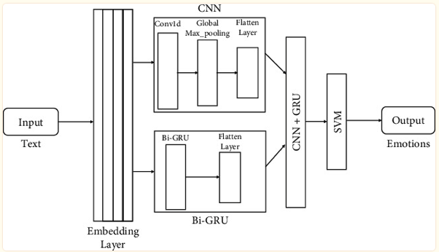
Related Works cont.
Preprocessed texts are embedded using word2vec. Their best performing model is a hybrid of CNN, SVM, and Bi-GRU. Limited because it’s traditional classification.
Shows evidence that a neural network with a cross entropy loss function is an optimal solution for large-scale multilabel text classification tasks. Graph-CNN model is used for XMTC problems that are hierarchically organized. Experimenting with 5 embeddings models, their model with word2vec embedding outperformed the other models.
[3]
[3] SK. Bharti, S. Varadhaganapathy, et.al. “Text-Based Emotion Recognition Using Deep Learning Approach.” National Center for Biotechnology Information. Aug 2022. https://www.ncbi.nlm.nih.gov/pmc/articles/PMC9427219/
[4] F. Gargiulo, S. Silvestri, et. al. “Deep neural network for hierarchical extreme multi-label text classification” Science Direct. June 2019. https://www.sciencedirect.com/science/article/pii/S156849461930167X?casa_token=B7rq0VFzHiwAAAAA:pyDP-_Txh2dSRJ4s5NqP2xG7QY1B5ML0Wio7XbZriBbAO1bwshdsc12aUWmIMmDLM9g3-pgHzNM

Slide 6
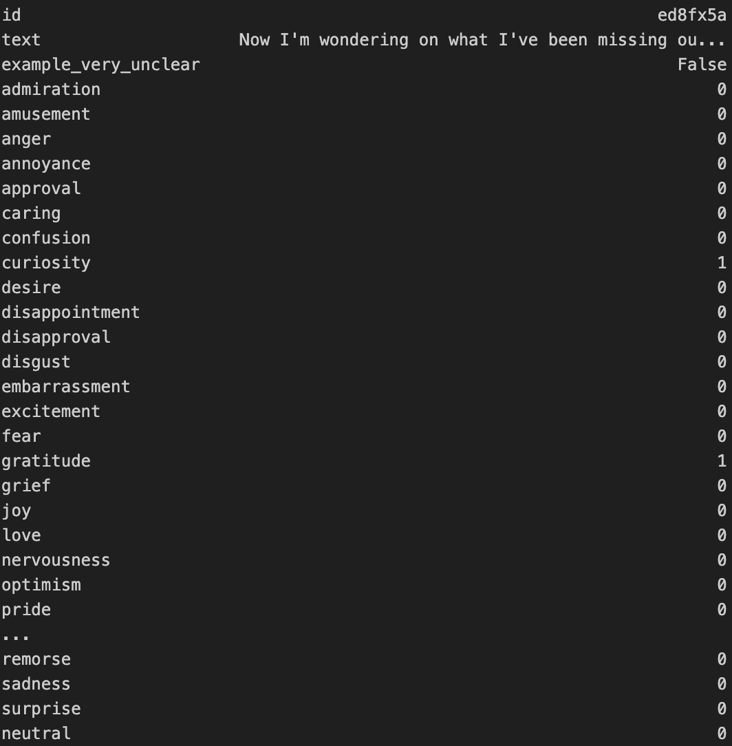


Problem Formulation
Multilabel text classification
Example:
Text: "Now I'm wondering on what I've been missing out. Again thank you for this."
Labels: Curiosity and Gratitude

Slide 7
Dataset Description
Google Research’s Go Emotions Dataset: 58k human-annotated Reddit text comments, labeled with 27 emotions
Original Dataset: 211,225 rows, 31 columns
Multiple instances of each text, each labeled differently…combined data of each text into one row, resulting in 58,009 rows
6 emotion classes:
anger | anger, annoyance, disapproval
disgust | disgust
fear | fear, nervousness
joy | joy, amusement, approval, excitement, gratitude, love, optimism, relief, pride, admiration, desire, caring
sadness | sadness, disappointment, embarrassment, grief, remorse
surprise | surprise, realization, confusion, curiosity
Emotion classes are derived from Ekman’s emotion grouping

Slide 8
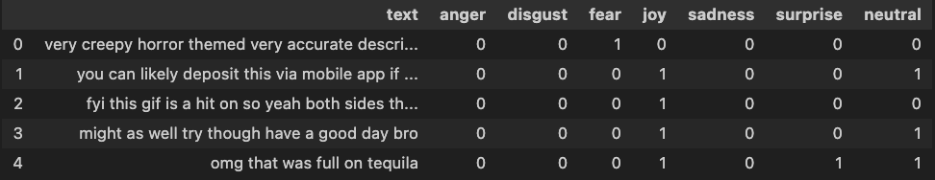
Datasets
Original Dataset
27 Emotions Dataset
6 Emotions Dataset

Slide 9
Multilabel Classification
Traditional classification only solves single label problems
Evaluated using traditional metrics: accuracy, precision, recall, and F1-score
Multilabel classification can assign more than one label per text
Need to change evaluation metrics to micro/macro precision, recall, and F1-score
Use micro/macro averaging to obtain a single number to describe the overall performance
Evaluation Metrics:
Precision = true positives / (true positives + false positives)
Recall = true positives / (true positives + false negatives)
F1-score = 2 * (precision * recall) / (precision + recall)
Micro: sum of all classes
Macro: average of individual classes
True positive: correct label
True negative: correctly doesn’t assign label
False positive: incorrect label
False negative: misses a label

Slide 10
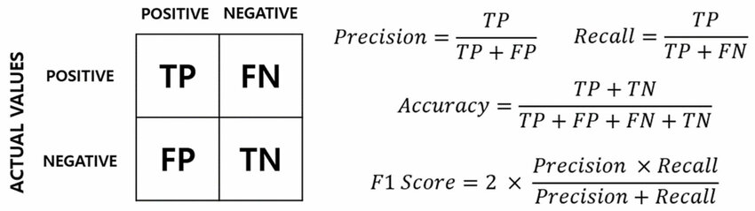
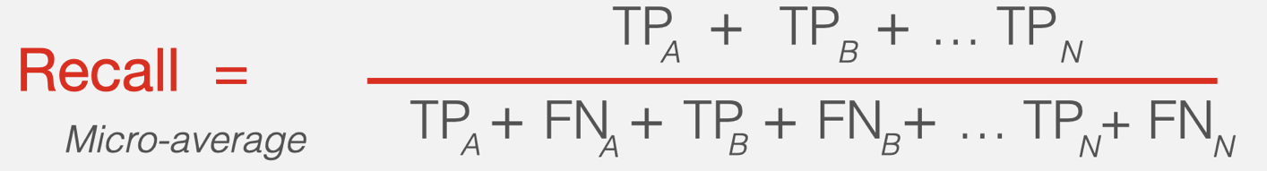
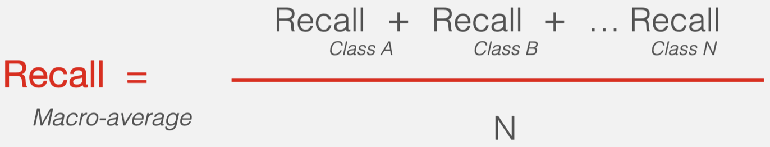
Evaluation Metrics
Precision | Recall
Measures the accuracy of assigning a positive Measure of quality Higher precision means the algorithm returns more relevant results than irrelevant ones. | Measures the ability of identifying positives Measure of quantity Higher recall means the algorithm returns most of the relevant results (independent of irrelevant ones are also returned).
Micro | Macro
Sum true positives & true/false negatives then calculate the metric Micro-averaging gives equal weight to each instance | Calculate metric for each class then average across all classes Macro-averaging gives equal weight to each class, regardless of the number of instances

Slide 11
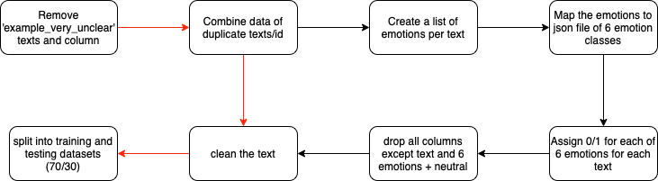
Preprocessing
Shape: (207814, 30)
Shape: (58009, 30)
Shape: (58009, 8)
Train size: 40,606
Test size: 17,403

Slide 12
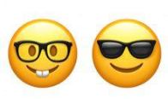
Preprocessing - Text Cleaning
I can’t colour anything cool
Remove emojis
Make lowercase
Remove HTML text
Clean contractions
(used dictionary for contraction mapping)
Clean special characters
Correct spelling
(used dictionary for misspelled words)
Remove excess spaces
i can’t colour anything cool
i can not colour anything cool
i can not color anything cool
i can not color anything cool

Slide 13

Algorithms
Used embeddings to represent preprocessed texts
model_id is a HuggingFace model
tokenizer = AutoTokenizer.from_pretrained(model_id)
max length of texts is 200
model = AutoModel.from_pretrained(model_id)
loss function = BCEwithLogitsLoss()
optimizer = AdamW
Learning rate = 1e-5
Weight decay = 1e-6
3 HuggingFace models:
Roberta-base
Bge-base-en-v.15
GIST-Embedding-v0

Slide 14
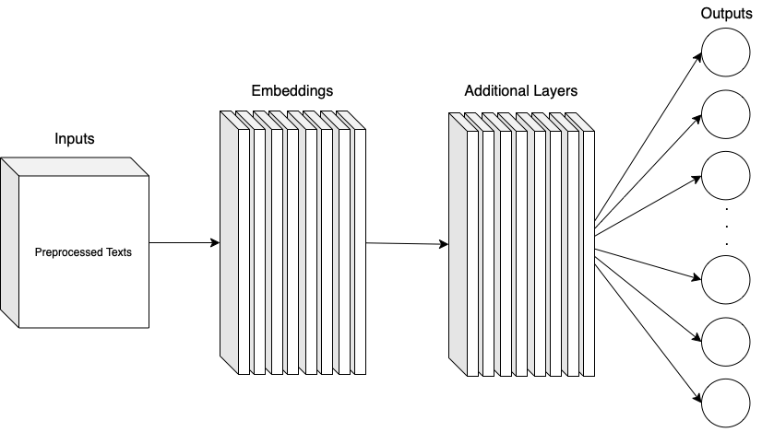
Model Architecture

Slide 15


Model Training
70/30 training and test splits
Trained for 20 epochs with a batch size of 64
Programming: used Python, Pytorch, HuggingFace
Machine: UML CS GPU server
Training Times:
6 emotions + neutral = ~ 65 minutes each model
27 emotions + neutral = ~ 140 minutes roberta, 65 GIST & bge

Slide 16
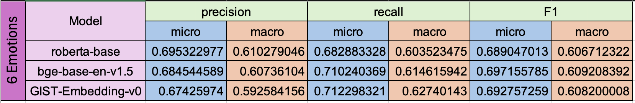
Results - 6 Emotions + Neutral
roberta-base has the best precision scores
GIST-Embedding-v0 has the best recall scores
bge-base-en-v1.5 has the best F1 scores

Slide 17
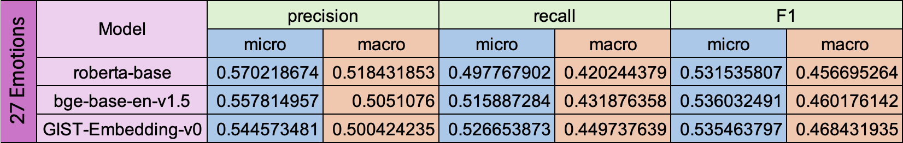
Results - 27 Emotions + Neutral
Lower metrics than 6 emotion classification, but the same model rankings
roberta-base has the best precision scores
GIST-Embedding-v0 has the best recall scores and macro F1 score
bge-base-en-v1.5 has the best micro F1 score

Slide 18
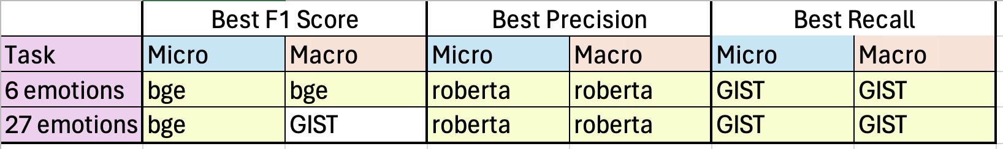
Discussion
Recall is the most important evaluation metric for comparing models.
False positives/negatives are equally bad, so F1 score is an important metric for model evaluation and it includes both precision and recall.
roberta-base is the worst model for both classification tasks because it has the lowest recall and F1 scores.

Slide 19

Conclusion
Implemented multilabel emotion classification algorithm with different embeddings
Found GIST-Embedding-v0 is the best model
Best recall scores for both classification tasks (micro and macro)
Also, best micro F1 score for 27 emotion classification
6 emotions yields better performance results than 27 emotions
GIST-Embedding-V0

Slide 20

Future Work
Multi-layer classification
27 emotion classification feeds into 6 emotions
Hierarchical multilabel classifier
Directed acyclic graph format where each object can have multiple paths in the class hierarchy
Modifying the loss function and model parameters

Slide 21

Questions

